Slide 1
Gentle* Introduction to Modern C++
Mihai Todor
* Well, maybe not so gentle ☺
Disclaimer: This presentation is focused on C++11 features and assumes a basic understanding of C++

Slide 2
Intro I
C++ is boring / hard to get right
The C++ compilers are buggy
We don’t want to mess with it

Slide 3
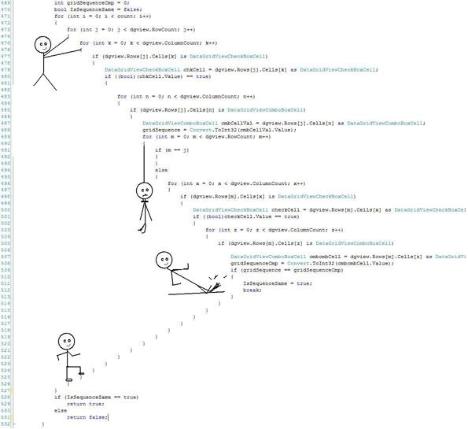
Intro II
And your code looks like this*:
*That’s actually C# code, but you get the point ☺

Slide 4
Intro III
WRONG MENTALITY!

Slide 5
Intro IV
In spite of the fact that it lacks some of the C# flexibility and compactness, C++ is a beautiful language, having a rich syntax, which enables a high degree of expressivity and abstraction, with a fine grained control over resource consumption.

Slide 6
Intro V
If done right, in C++ you only pay for what you use
If done wrong, in C++ you blow your entire leg off, not just a toe

Slide 7
Intro VI
The compiler is never* wrong
C++11 features alleviate much of the pain we had to endure when architecting code
The STL is becoming richer and more flexible
Compilers are adopting new features much faster
*well, maybe sometimes, but it usually requires more than 10 minutes of coding to stumble upon a legit compiler bug

Slide 8
Some modern C++ features
Move semantics
Auto
nullptr
Range-based for loops
override and final
Strongly-typed enums
Lambdas
Explicitly defaulted and deleted functions
Smart pointers

Slide 9
Move semantics
Copies are expensive!
Want speed, pass by value (not always*)
Moving variables can be as cheap as a pointer swap
Classes can now have move constructors and move assignment operators
* http://juanchopanzacpp.wordpress.com/2014/05/11/want-speed-dont-always-pass-by-value/

Slide 10
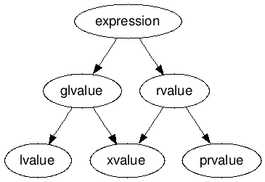
Move semantics II
In C++11, an expression can be:
The && operator has been introduced in order to declare an rvalue reference
Diagram shamelessly ripped from here: http://stackoverflow.com/a/3601748/1174378

Slide 11
Move semantics III
xvalue (an “eXpiring” value) – also refers to an object, usually near the end of its lifetime
  A type Type followed by && represents an rvalue reference
  xvalues are explicit moves, created by std::move
prvalue (“pure” rvalue) - an rvalue that is not an xvalue (implicit moves)

Slide 12
Move semantics IV
A reference type that is declared using & is called an lvalue reference
A reference type that is declared using && is called an rvalue reference.

Slide 13
Move semantics V
Powerful tools in the <utility> header:
  std::move
  std::forward
  std::make_move_iterator
A thorough explanation for std::move and std::forward:
http://blogs.msdn.com/b/vcblog/archive/2009/02/03/rvalue-references-c-0x-features-in-vc10-part-2.aspx

Slide 14
auto
Repurposed keyword (initially, it designated a storage duration specifier)
Similar to C#’s var keyword
Reduces code verbosity by deducing a variable’s type from the initializer
Also allows return type deduction (C++14)
Potential for abuse!

Slide 15
nullptr
Eliminates the ambiguous conversion between NULL (#defined as 0) and integral types
Denotes a value of type std::nullptr_t
Converts implicitly to bool (as false) and null pointer values of any type
You don’t have to test a variable for null with both NULL and nullptr!
  int *pointer = LegacyGetInt();
  if (pointer != nullptr && pointer != NULL)//both tests are equivalent

Slide 16
Range-based for loops
They resemble the C# foreach statement
Syntax: for (auto value: collection) {/* do stuff */}
  the type specifier of value determines how the collection items are iterated: by value, by reference, by const reference, etc
Can be used with any type for which non-member overloads of the begin() and end() functions are implemented
  see NonMemberBeginAndEnd.cpp

Slide 17
override and final
If override is added to the declaration of a virtual method, which does not override a virtual method from the base class, the compiler emits an error
If final is added to the declaration of a virtual method, then derived classes are not allowed to override this method
  in C++, the virtual specifier is optional for derived class override methods
If final is added to the declaration of a class, then no other classes can derive from that class. This resembles C#’s sealed keyword

Slide 18
Strongly-typed enums
Eliminate issues caused by regular enums: namespace pollution and implicit conversions
For now, there is no simple way to use these in the same way as a C# flags enum (tagged enumeration)
The enum class underlying type can be specified by the user:
  enum class Colors : std::int8_t { RED = 1, GREEN = 2, BLUE = 3 };
Extracting underlying values of an enum class requires an explicit cast:
auto blue = static_cast<std::underlying_type<Colors>::type>(Colors::Blue);

Slide 19
Smart pointers
They provide reference counting in order to enable the automatic release of memory
Concerns about performance degradation / extra memory consumption are, indeed, legitimate, but in most cases we are not creating millions of objects on the heap to have really tight constraints
std::unique_ptr – Guarantees unique ownership of a memory resource. It cannot be copied (only moved to another std::unique_ptr).
  Created with std::make_unique (C++14)
std::auto_ptr is obsolete! Please replace it on sight with std::unique_ptr.

Slide 20
Smart pointers II
std::shared_ptr – Allows shared ownership of a memory resource
  Created with std::make_shared (C++11)
std::weak_ptr – Holds a reference to an object managed by an std::shared_ptr.
  does not contribute to the reference count
  Ensures that cycles are broken
std::static_pointer_cast, std::dynamic_pointer_cast and std::const_pointer_cast are your friends!

Slide 21
Lambdas
C++11 introduces support for anonymous functions, namely lambdas
Fine-grained control over variable capture
By default, variables captured by value are const, unless the mutable specification is present
We can have recursive lambdas

Slide 22
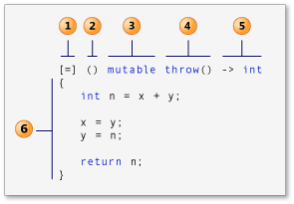
Lambdas II
Syntax (shamelessly ripped from MSDN*)
  lambda-introducer (Also known as the capture clause)
  lambda declarator (Also known as the parameter list). Optional!
  mutable (Also known as the mutable specification) . Optional!
  exception-specification (Also known as the exception specification) . Optional!
  trailing-return-type (Also known as the return type) . Optional!
  compound-statement (Also known as the lambda body)
* http://msdn.microsoft.com/en-us/library/dd293603.aspx

Slide 23
Explicitly defaulted and deleted functions
The rules which specify when the implicitly-declared default constructor and destructor, copy and move constructors and copy and move assignment operators get generated are somewhat complex, so C++11 allows you to force the compiler to generate them or not, via the =default and =delete specifiers.
Please take the Rules of three/five/zero into account when using these specifiers!

Slide 24
Explicitly defaulted and deleted functions II
Let’s design a trivial object, which can be constructed and moved, but not copied
class UniqueObject
{
public:
UniqueObject() =default;
~UniqueObject() =default;
UniqueObject(const UniqueObject &obj) =delete;
UniqueObject &operator=(const UniqueObject &obj) =delete;
UniqueObject(UniqueObject &&obj) =default;
UniqueObject &operator=(UniqueObject &&obj) =default;
};

Slide 25
More modern C++ features?
static_assert and type traits
Mutable
Constructor delegation
  http://www.nullptr.me/2012/01/17/c11-delegating-constructors/
Uniform initialization
  http://programmers.stackexchange.com/questions/133688/is-c11-uniform-initialization-a-replacement-for-the-old-style-syntax
rvalue reference for *this
  http://stackoverflow.com/questions/12306226/what-does-an-ampersand-after-this-assignment-operator-mean
Many more…

Slide 26

See my activity on StackOverflow:
stackoverflow.com/users/1174378/mihai-todor
Follow me on:
Twitter: @MihaiTodor
Linkedin: www.linkedin.com/mtodor
Github: github.com/mihaitodor

